Slide 1
UNIT-4 Embedded OS
OPERATING SYSTEM CONCEPTS
UNIT-4
Embedded OS

Slide 2
Embedded OS
An embedded operating system (OS) is a specialized operating system designed to perform a specific task for a device that is not a computer.
An embedded operating system's main job is to run the code that allows the device to do its job.
The most common examples of embedded operating system around us include Windows Mobile/CE (handheld Personal Data Assistants), Symbian (cell phones) and Linux.
Flash Memory Chip is added on a motherboard in case of the embedded operating system of your personal computer to boot from the Personal Computer.

Slide 3
Embedded OS
Embedded System is a combination of computer software and hardware which is either fixed in capability or programmable.
An embedded system can be either an independent system, or it can be a part of a large system.
It is mostly designed for a specific function or functions within a larger system.
For example, a fire alarm is a common example of an embedded system which can sense only smoke.

Slide 4
key characteristics of Embedded Systems
All Embedded Systems are task specific. They do the same task repeatedly /continuously over their lifetime. An mp3 player will function only as an mp3 player.
Embedded systems are created to perform the task within a certain time frame. It must therefore perform fast enough. A car’s brake system, if exceeds the time limit, may cause accidents.
They have minimal or no user interface (UI). A fully automatic washing machine works on its own after the programme is set and stops once the task is over.
Some embedded systems are designed to react to external stimuli and react accordingly. A thermometer, a GPS tracking device.

Slide 5
key characteristics of Embedded Systems
Embedded systems are built to achieve certain efficiency levels. They are small sized, can work with less power and are not too expensive.
Embedded systems cannot be changed or upgraded by the users. Hence, they must rank high on reliability and stability. They are expected to function for long durations without the user experiencing any difficulties.
Microcontroller or microprocessors are used to design embedded systems.
Embedded systems need connected peripherals to attach input & output devices.
The hardware of an embedded-system is used for security and performance. The Software is used for features.

Slide 6
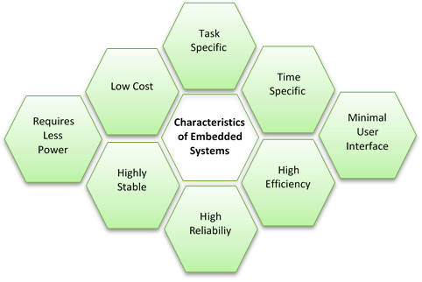
Characteristics of an Embedded System

Slide 7
Types of embedded system
Embedded Systems can be classified into four types based on the performance and functional requirement.
Stand-Alone Embedded Systems.
Real Time Embedded Systems.
Networked Embedded Systems.
Mobile Embedded Systems.

Slide 8
Stand Alone Embedded Systems
Stand-Alone Embedded Systems are those that can work by themselves i.e. they are self-sufficient and do not depend on a host system.
Stand-alone embedded systems are made in a way such that an input is received, processed and thereafter the desired output is produces.
Input can be received via sensors, keyword or push button.

Slide 9
Real Time Embedded Systems
A Real Time Embedded System provides output within a defined specific time.
That is, real time embedded systems are designed and created to perform some specific work in pre-specified time.
Types of Real Time Embedded Systems
There are two types of Real Time Embedded System. They are:
Soft Real Time Embedded Systems
Hard Real Time Embedded Systems

Slide 10
Networked Embedded Systems
Networked Embedded Systems depend on connected network to perform its assigned tasks.
These systems consist of components like sensors, controllers etc. which are interconnected.
Many of these systems are built on general purpose processors.

Slide 11
Mobile Embedded Systems
Mobile Embedded Systems are those that are small sized and can be used in smaller devices.
They are used in mobile phones and digital cameras because of the small size.
They often have memory constraints and lacks good user interface.

Slide 12
Examples of embedded OS
Refers to the use of electronics and software within a product that is designed to perform a dedicated function
Embedded systems are part of a larger system or product
Antilock braking system in a car would be an example
The most common examples of embedded operating system around us include Windows Mobile/CE (handheld Personal Data Assistants), Symbian (cell phones) and Linux.
Flash Memory Chip is added on a motherboard in case of the embedded operating system of your personal computer to boot from the Personal Computer.
Laser Printer
Laser Printers are one of the examples of Embedded Systems which uses embedded systems to manage various aspect of the printing.
Apart from performing the main task of printing, it has to take user inputs, manage communication with the computer system, to handle faults, and sense papers left on the tray, etc.

Slide 13
Applications of embedded OS
Robotic science: Ground Vehicles Drones Underwater Vehicles Industrial Robots | Medical Dialysis Machine Infusion Pumps Cardiac Monitor Prosthetic Device
Automotive Engine Control Ignition System Brake System | Networking Router Hubs Gateways Electronics Instruments
Home Devices: TVs Digital Alarm Air Conditioner DVD Video Player Cameras | Automobiles Fuel Injection Lighting System Door Locks Air Bags Windows Parking Assistant System Anti-stealing Alarms Whippers Motion

Slide 14
Thank You
Have a Good Day!

